Slide 1
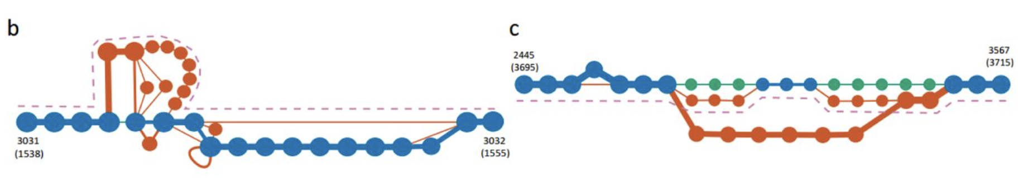
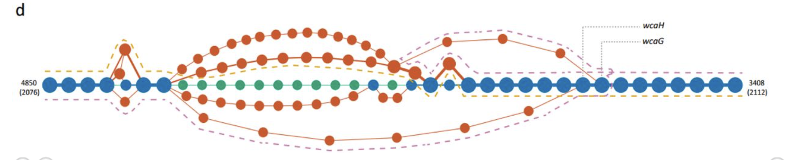
pangenomes
Object-based pangenome

Slide 2
Democratic prices allow for the sequencing of many genomes
No single reference anymore
Pangenome = Sum of all individual sequences found within a species
Pangenome analyses of a species provides insights
into core- and accessory-genome profiles,
within-species genetic diversity,
evolutionary dynamics
niche-specific adaptions.

Slide 3
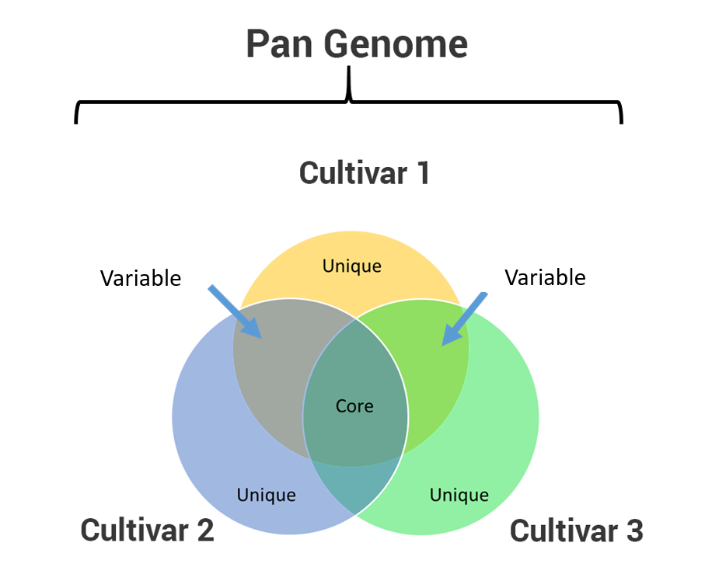
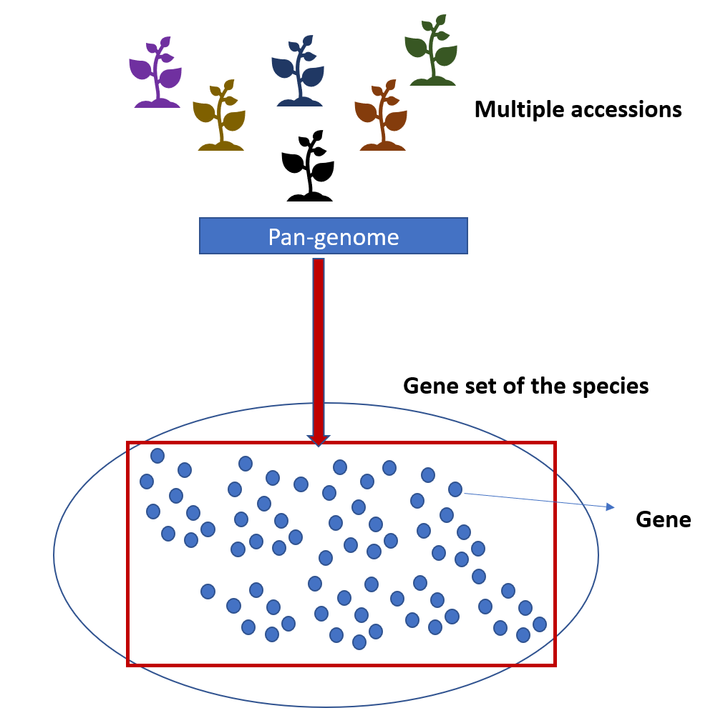
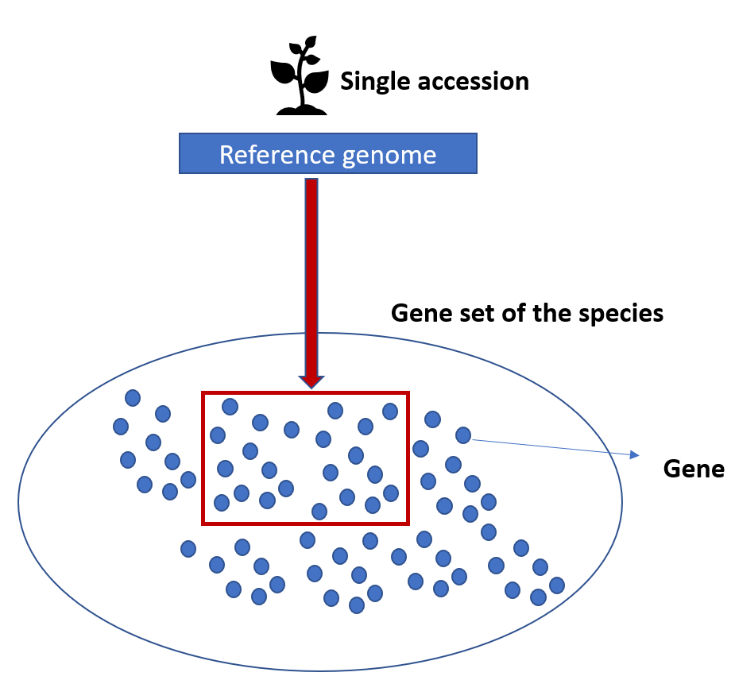
Single reference is not representative for the genetic diversity within the population
Expanding reference genome using other accessions’ sequencing data could comprehensively represent the genetic diversity
PANGENOME DEFINITION

Slide 4
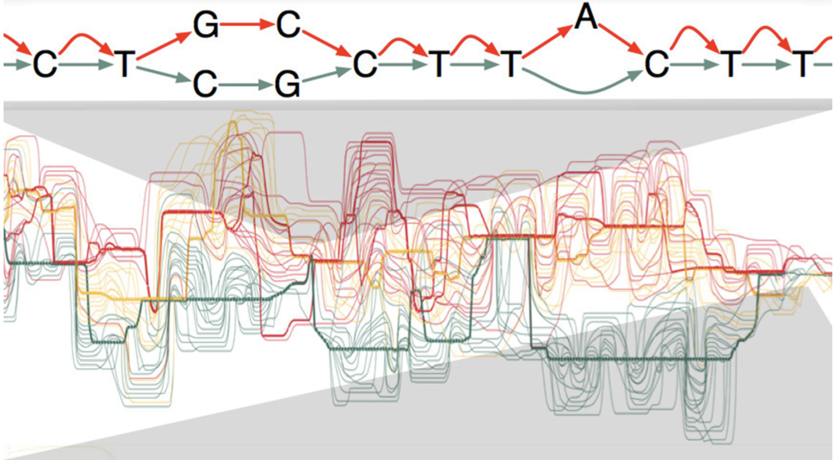
Representation of a pangenome
Early on: bacterial genomes (small genomes, mostly coding)
“cheaper” to sequence, small genomes
Pan-proteomes
Larger genomes: NGS democratises the access to multiple genomes.
Left-over reads that do not match a reference genome, being assembles as extra bits of genome.
Represents the pan-genomes as a reference genome with extra (unplaced) contigs
DeBruyn-graph
Larger + multiple genome
Building the pan genome becomes costly

Slide 5
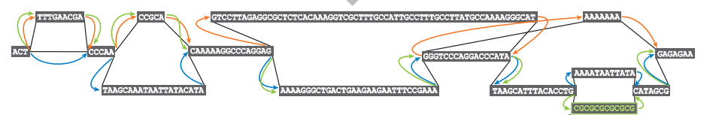
Graph pangenomes
Nucleotide based pangenome
Object based pangenome
MANY IN LITERATURE
NOT IN LITERATURE
Genome 1
Genome 2
Genomic sequences
Genome 3
Gene
 | Nucleotide based pangenome | Object based pangenome
NODE | Nucleotide sequences | Genes, TE, …. (any object that in anchored on the genomic sequence)
EDGES | a walk in the graph describes a genome | Any relationships between genes
AIM | Core, variable and unique genomic regions of accessions | Core, variable and unique objects of accessions
ADVANTAGE | Visualization of Indel,SV and SNPs | visualization of shared and Unique genes (objetcs)
DISADVANTAGE | No visualization of Core,Variable and Unique objects | No visualization of SNV, Indel and SV visualization for cultivar

Slide 6
object-based pangenome
As opposed to nucleotide-based type, OBJECT-BASED PANGENOME requires that every cultivar included should have:
An accurate/complete GENOME PHASED ASSEMBLY
An accurate/complete GENE ANNOTATION
Genome 1
Genome 2
Genome 3
Gene

Slide 7


Graph → graph-database
Platforms:
NEO4J
“popular” among data scientists, free environment, cypher language, https://neo4j.com/
Vaticle
a strongly-typed database
TypeDB is a database with a rich and logical type system. TypeDB empowers you to solve complex problems, using TypeQL as its query language.

Slide 8
Graph-database
= data points (objects) that “for some reason” interact with each other.
Order of genes along a chromosome
Synteny between chromosomes (within/across genomes)
Because of sequence homology (gene families)
Because of PPI, GRN, GCN
…
But graph-databases do not have a predefined structure, which is fine for the data and queries
Visualisation needs to be developed for easier interpretation: e.g. represeenting chromosomes as linear “beads on a string”

Slide 9
a rich and logical type system
Concepts (e.g. as described in ontologies) will define the data and it’s interactions/connections
TypeDB allows to model a domain based on logical and object-oriented principles. Composed of entity, relationship, and attribute types, as well as type hierarchies, roles, and rules, TypeDB allows you to think higher-level
as opposed to join-tables, columns, documents, vertices, edges, and properties
spatial sub relation, relates source, relates target;
synteny sub relation, relates source, relates target;
orthology sub relation, relates source, relates target;
gene sub entity, owns name, owns cultivar, owns real_identifier, owns contig, owns coordinates, owns function, plays spatial:source, plays spatial:target, plays synteny:source, plays synteny:target, plays orthology:source, plays orthology:target;

Slide 10
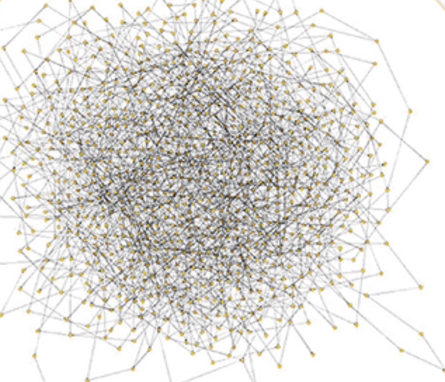
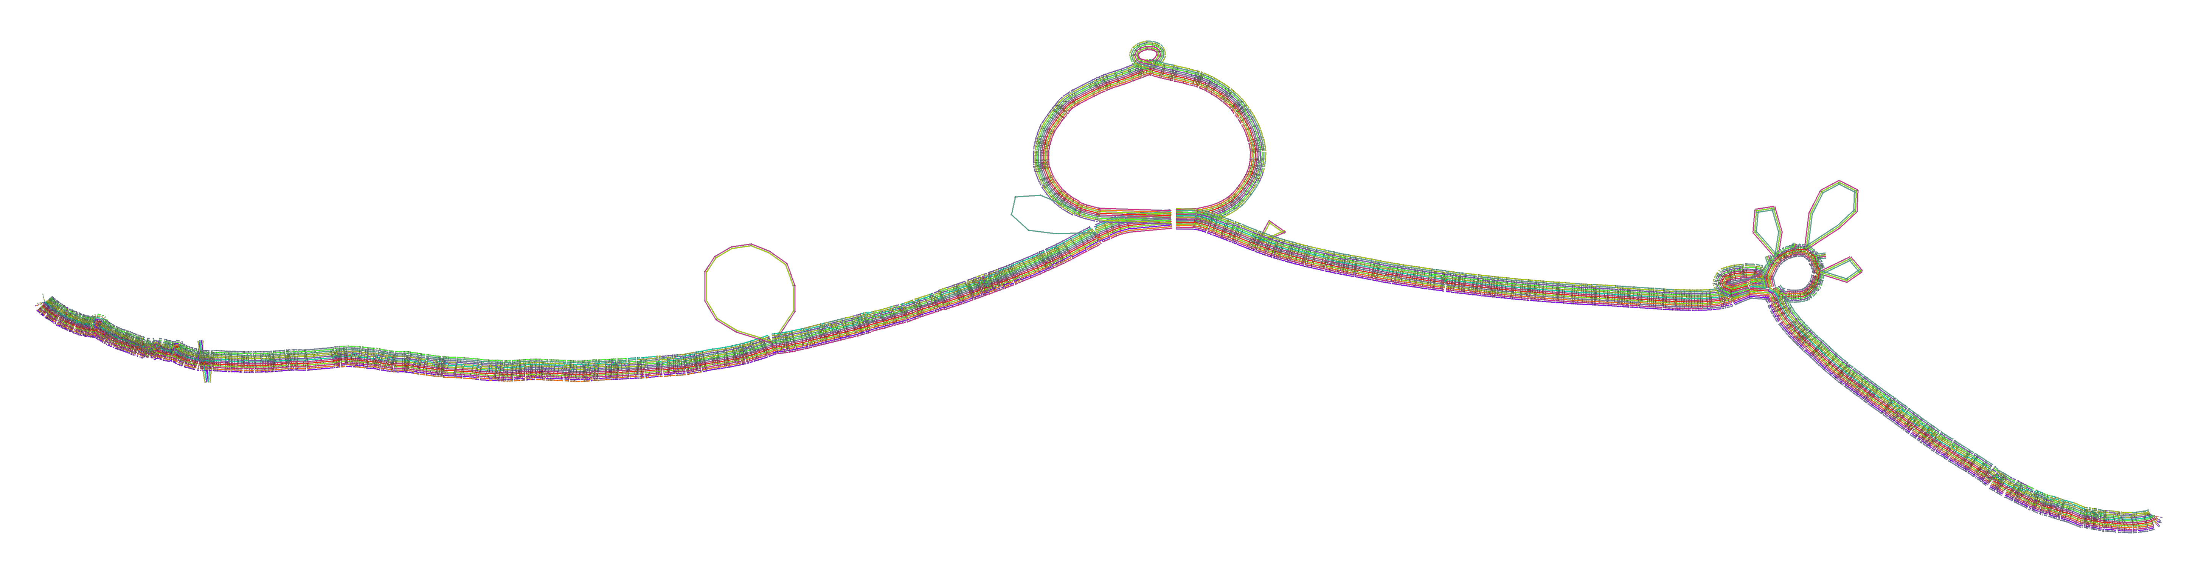
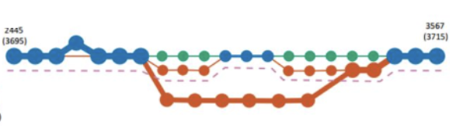
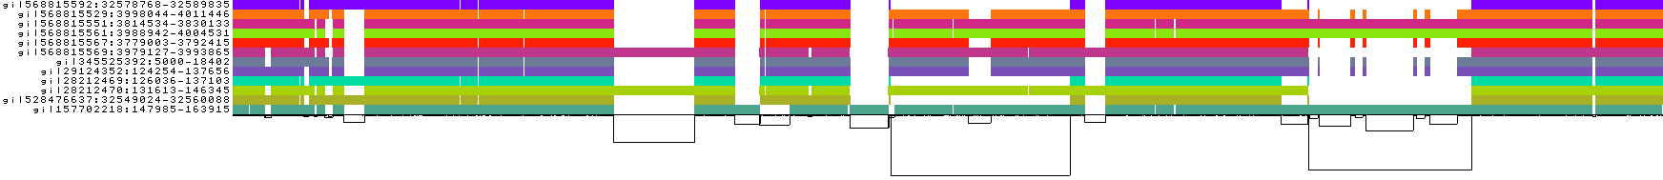
Project aim : development
The graph structure in a graph database (TypeDB) is data driven and free.
But some data in the database has an intrinsic structure
E.g. the order of the genes along a chromosome.
Need to develop a visualization that differentiates structured parts of the data for other data (structure free)

